Slide 1
WEEK -03 LECTURE
PARALLE AND DISTRIBUTED COMPUTING

Slide 2
Asynchronous/synchronous computation/communication,
The key difference between synchronous and asynchronous communication is synchronous communications are scheduled, real-time interactions by phone, video, or in-person. Asynchronous communication happens on your own time and doesn't need scheduling.
Synchronous execution means the first task in a program must finish processing before moving on to executing the next task whereas asynchronous execution means a second task can begin executing in parallel, without waiting for an earlier task to finish.

Slide 3
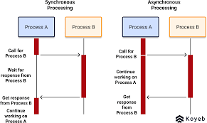

Slide 4
Synchronous | Asynchronous
It sends data in the form of blocks or frames. | Data is sent in the form of character or byte.
Synchronous Transmission is fast. | Asynchronous transmission method is slow.
Synchronous Transmission is costly. | Asynchronous Transmission is economical.

Slide 5
· Concurrency control
If many transactions try to access the same data, then inconsistency arises. Concurrency control required to maintain consistency data. For example, if we take ATM machines and do not use concurrency, multiple persons cannot draw money at a time in different places. This is where we need concurrency.
The property or an instance of being concurrent; something that happens at the same time as something else. a property of systems where several processes execute at the same time.

Slide 6
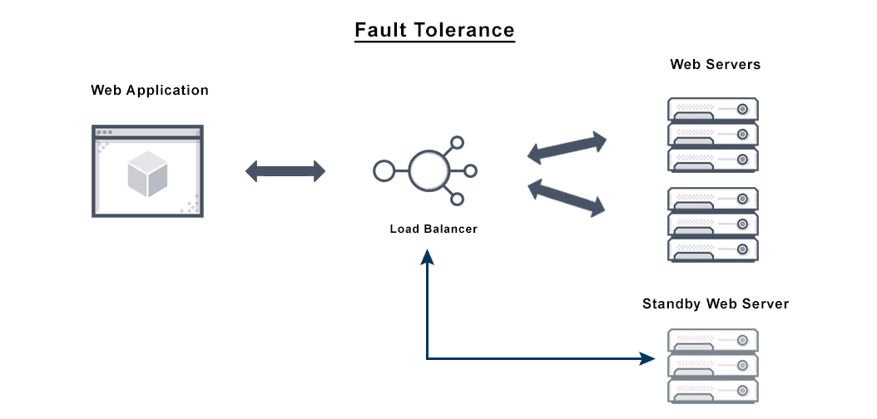
· Fault tolerance
Fault Tolerance simply means a system's ability to continue operating uninterrupted despite the failure of one or more of its components. This is true whether it is a computer system, a cloud cluster, a network, or something else.

Slide 7
· Case Studies: From problem specification to a parallelized solution
Assignment

